Slide 1
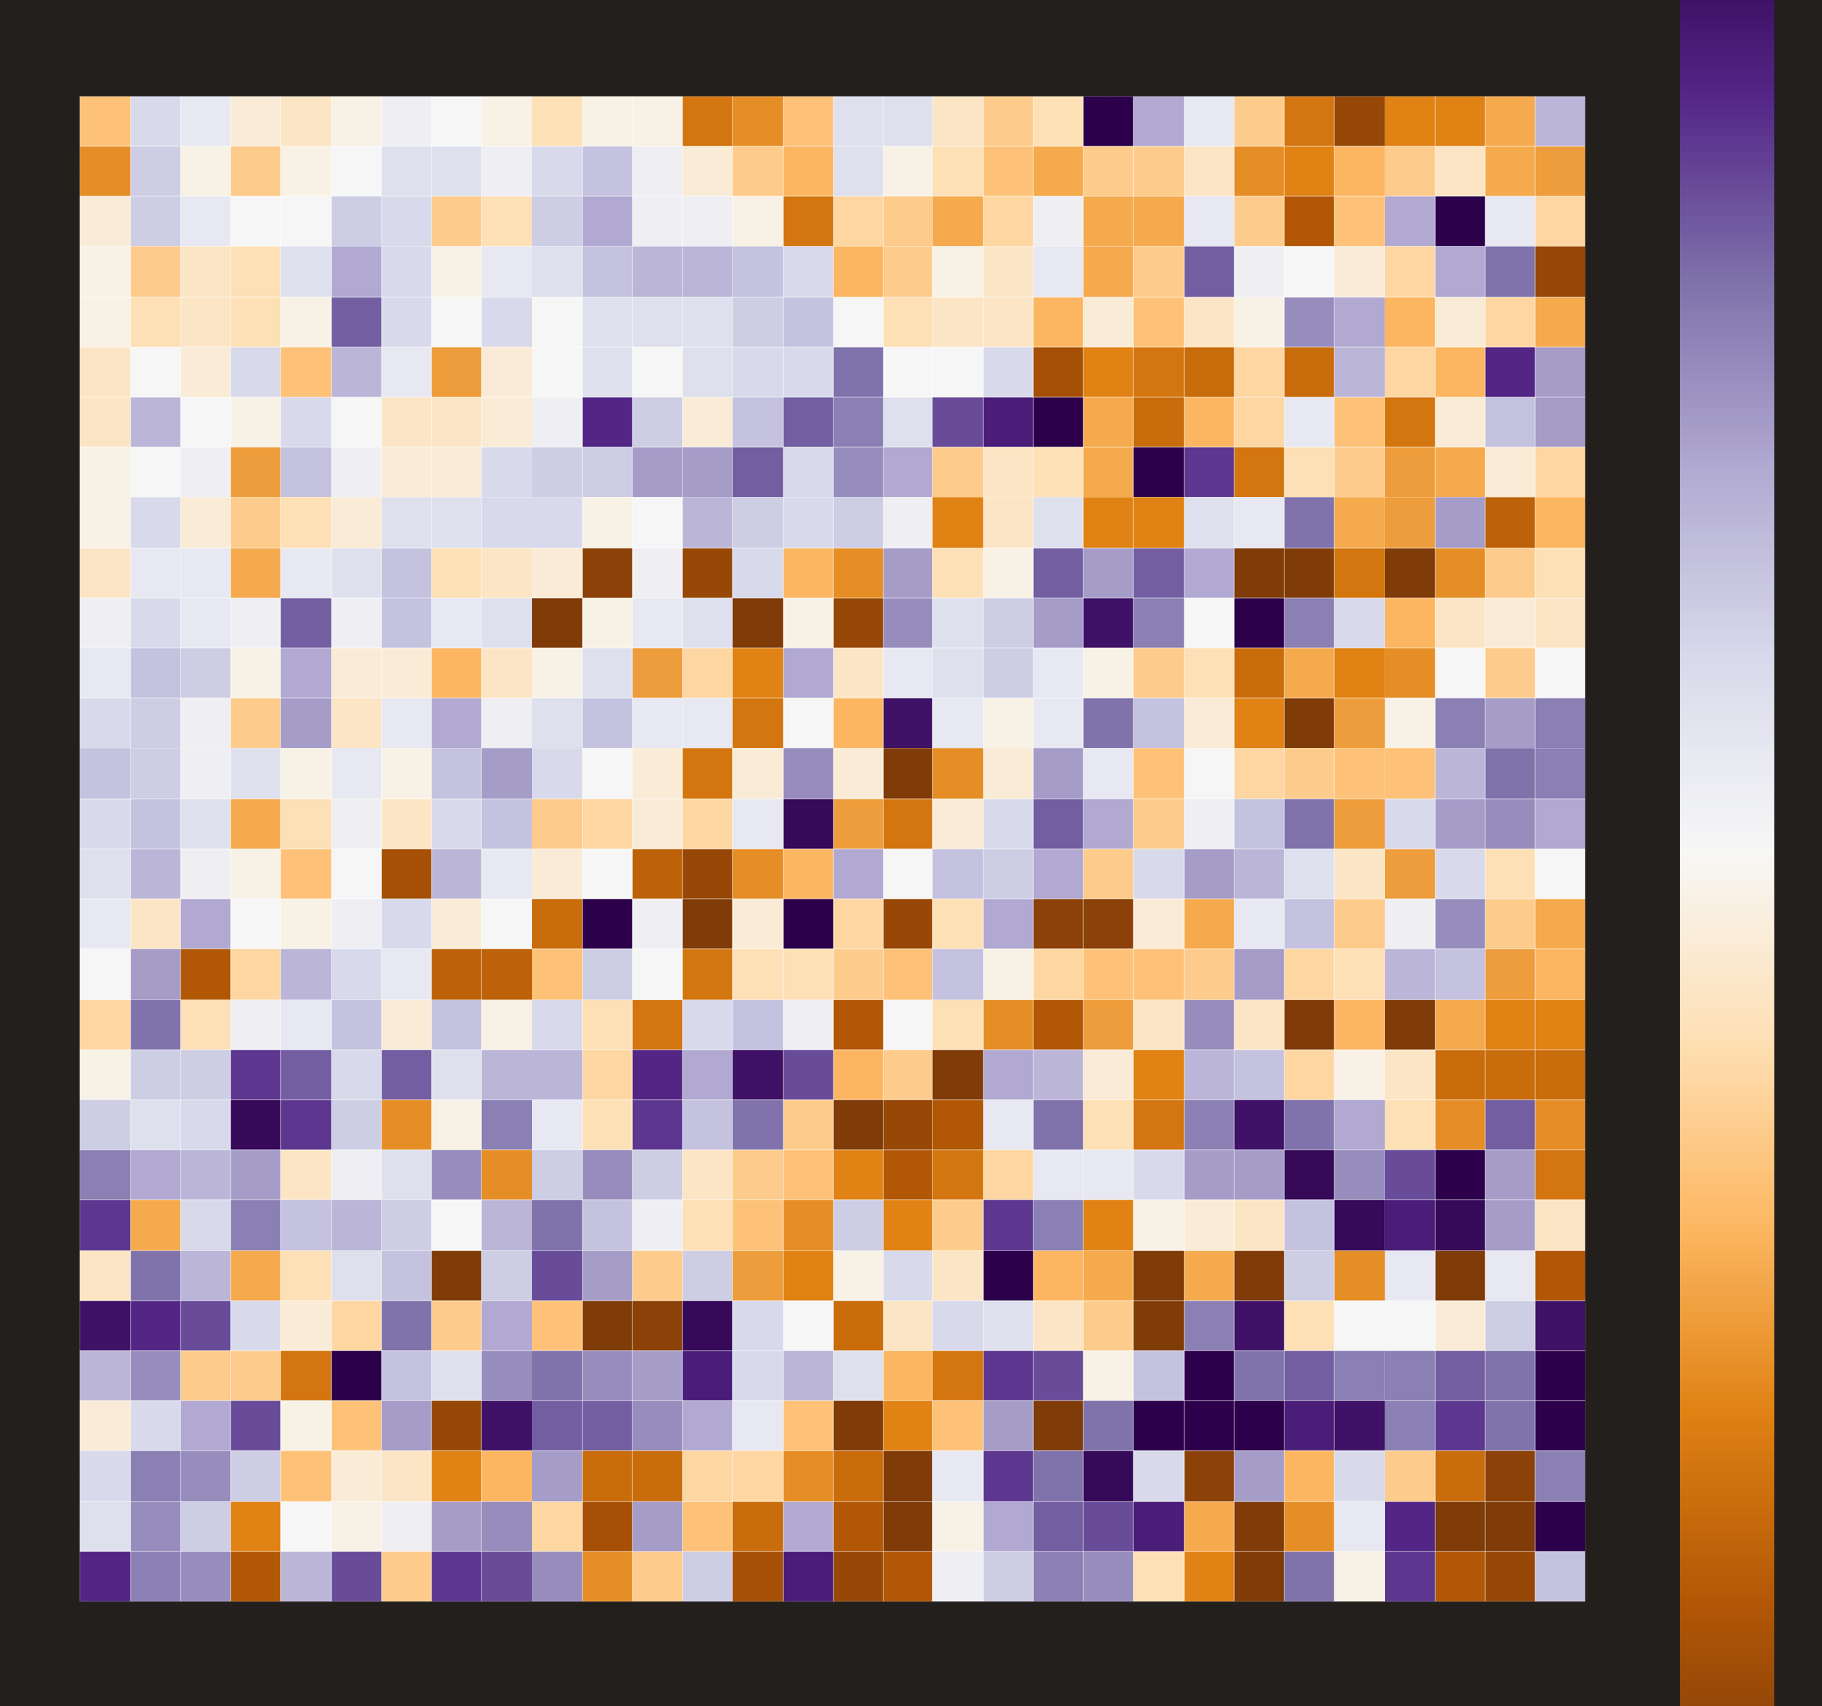
Game-Based Redistricting for Small-Population States
Maia Pietraho
Brunswick High School
Brunswick, Maine

Slide 2
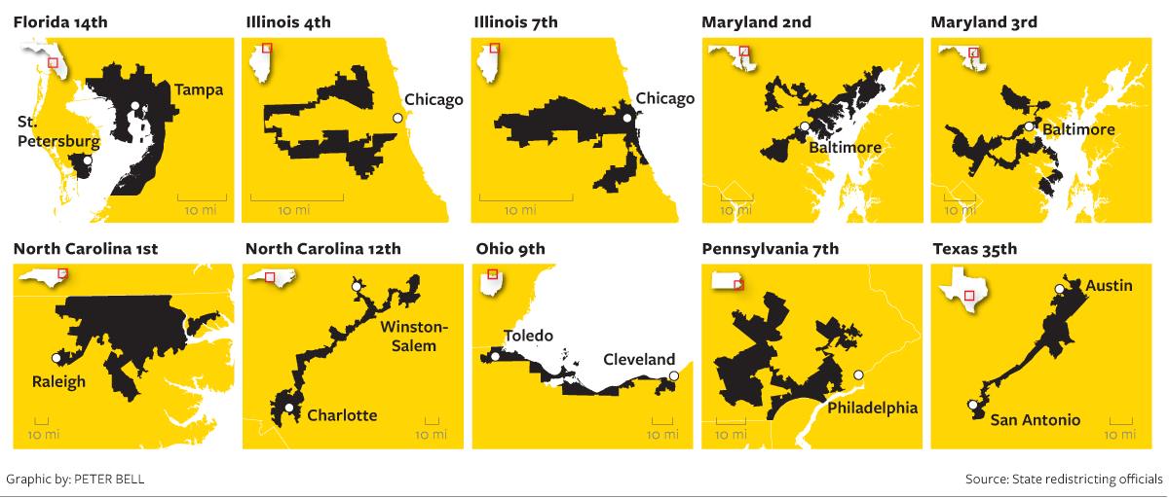
Gerrymandering
Problem: Congressional districts are often perceived as being biased towards specific parties or groups due to suspected gerrymandering. This erodes the people’s trust in our political system.

Slide 3













Mathematicians and Computer Scientists working on Gerrymandering
Moon Duchin (Tufts, MGGG)
Wesley Pegden (CMU)
Ranthony Edmonds (OSU)
Daryl DeFord (WSU)
Thomas Weighill (UNC)
Jonathan Mattingly (Duke)

Slide 4
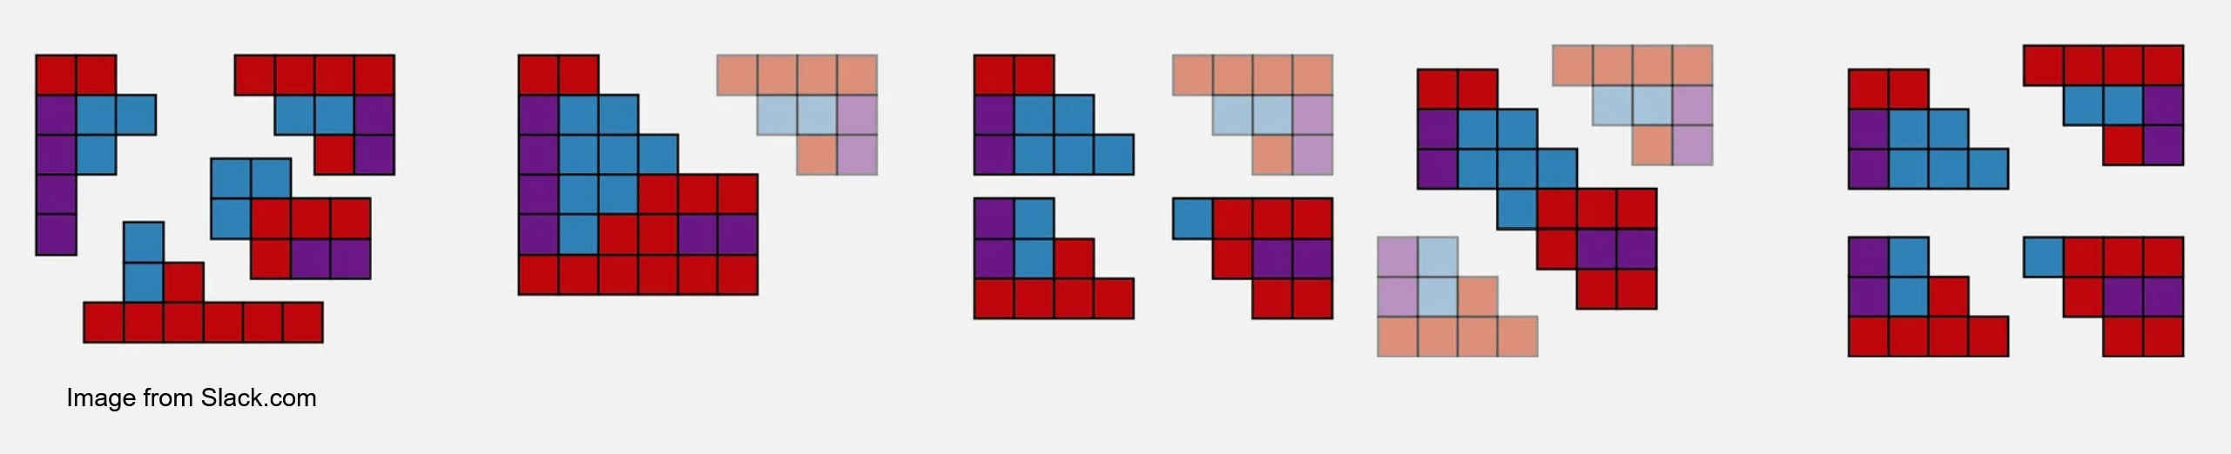
I-Cut-You-Freeze State Redistricting
A game-based method proposed by Wesley Pegden, Ariel D. Procaccia, and Dingli Yu.
There are two players, each representing a political party.
Player A takes a state and fully divides it into districts.
Player B chooses one district to keep, or freeze, then discards the rest of the proposed districts, and redraws them.
Player A then freezes another district, and this pattern continues until all districts have been chosen.
Note: This method is terrible for two-district states!

Slide 5
Research Question: Is it possible to design a game that adapts the I-Cut-You-Freeze method of redistricting to two-district states?
To be politically viable, such a game must:
Follow simple rules,
Create compact, that is regularly-shaped, and continuous districts, and
Not admit a dominant strategy for either player.

Slide 6

My Proposed Game for Two-District States
Again, there are two players, each representing a political party. They alternate taking these two steps:
Selection step: A player selects a precinct to add to their district.
Validation step: The district made so far must be
continuous and compact
all unclaimed precincts can be added to either district
Otherwise the player must select another precinct.
Invalid configuration
The game ends when all precincts are chosen.

Slide 7
Procedure: Evaluating the Game’s Performance
I used the following steps to evaluate the game:
Create simulated states
To avoid bias and allow for many simulations to be run
Create computer players
The players will follow simple strategies when playing this game
Run simulated games
Vary parameters for states and player strategies.
Success if: the games always finish, the districts created are continuous and compact, and that there are no simple dominant strategies.

Slide 8
Details and Definitions

Slide 9
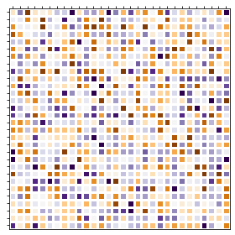
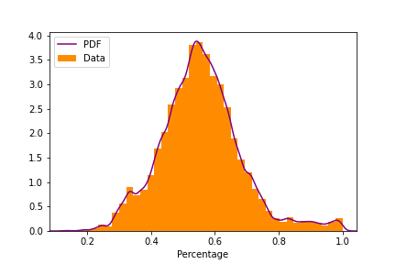
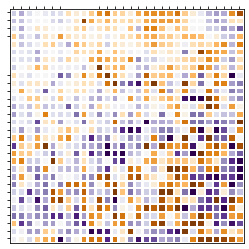
Simulating a State
Before Migration:
Simplified state: a 30x30 square grid of precincts.
Two parties: all voters in Orange or Purple party
Each precinct: randomly assigned percentage of Purple voters (bell curve with s.d. 10 and various means)
Migration: precincts with similar party distributions clumped by a migration algorithm.
After Migration:

Slide 10
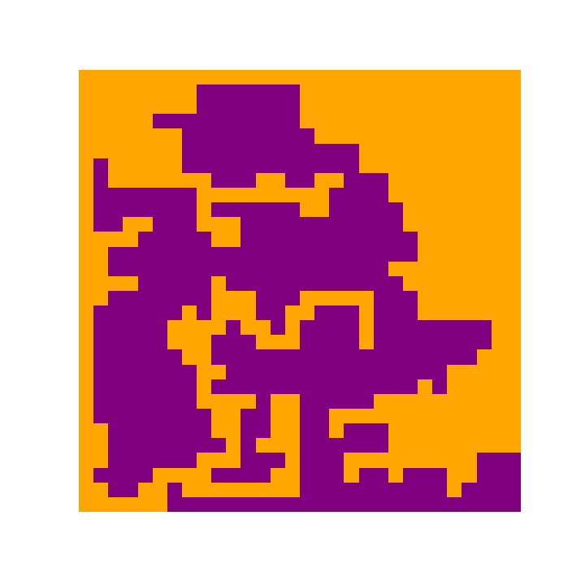


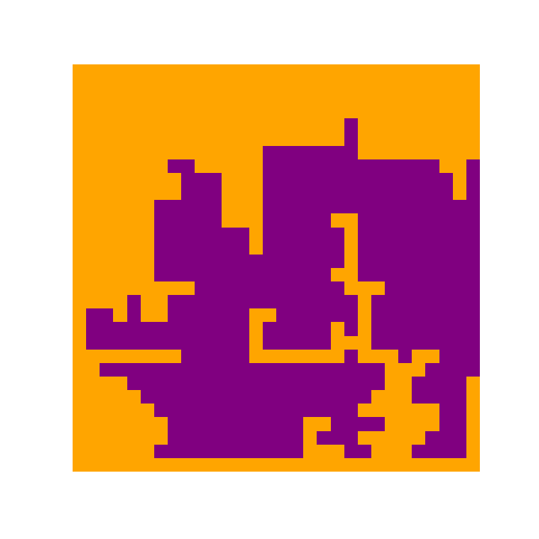


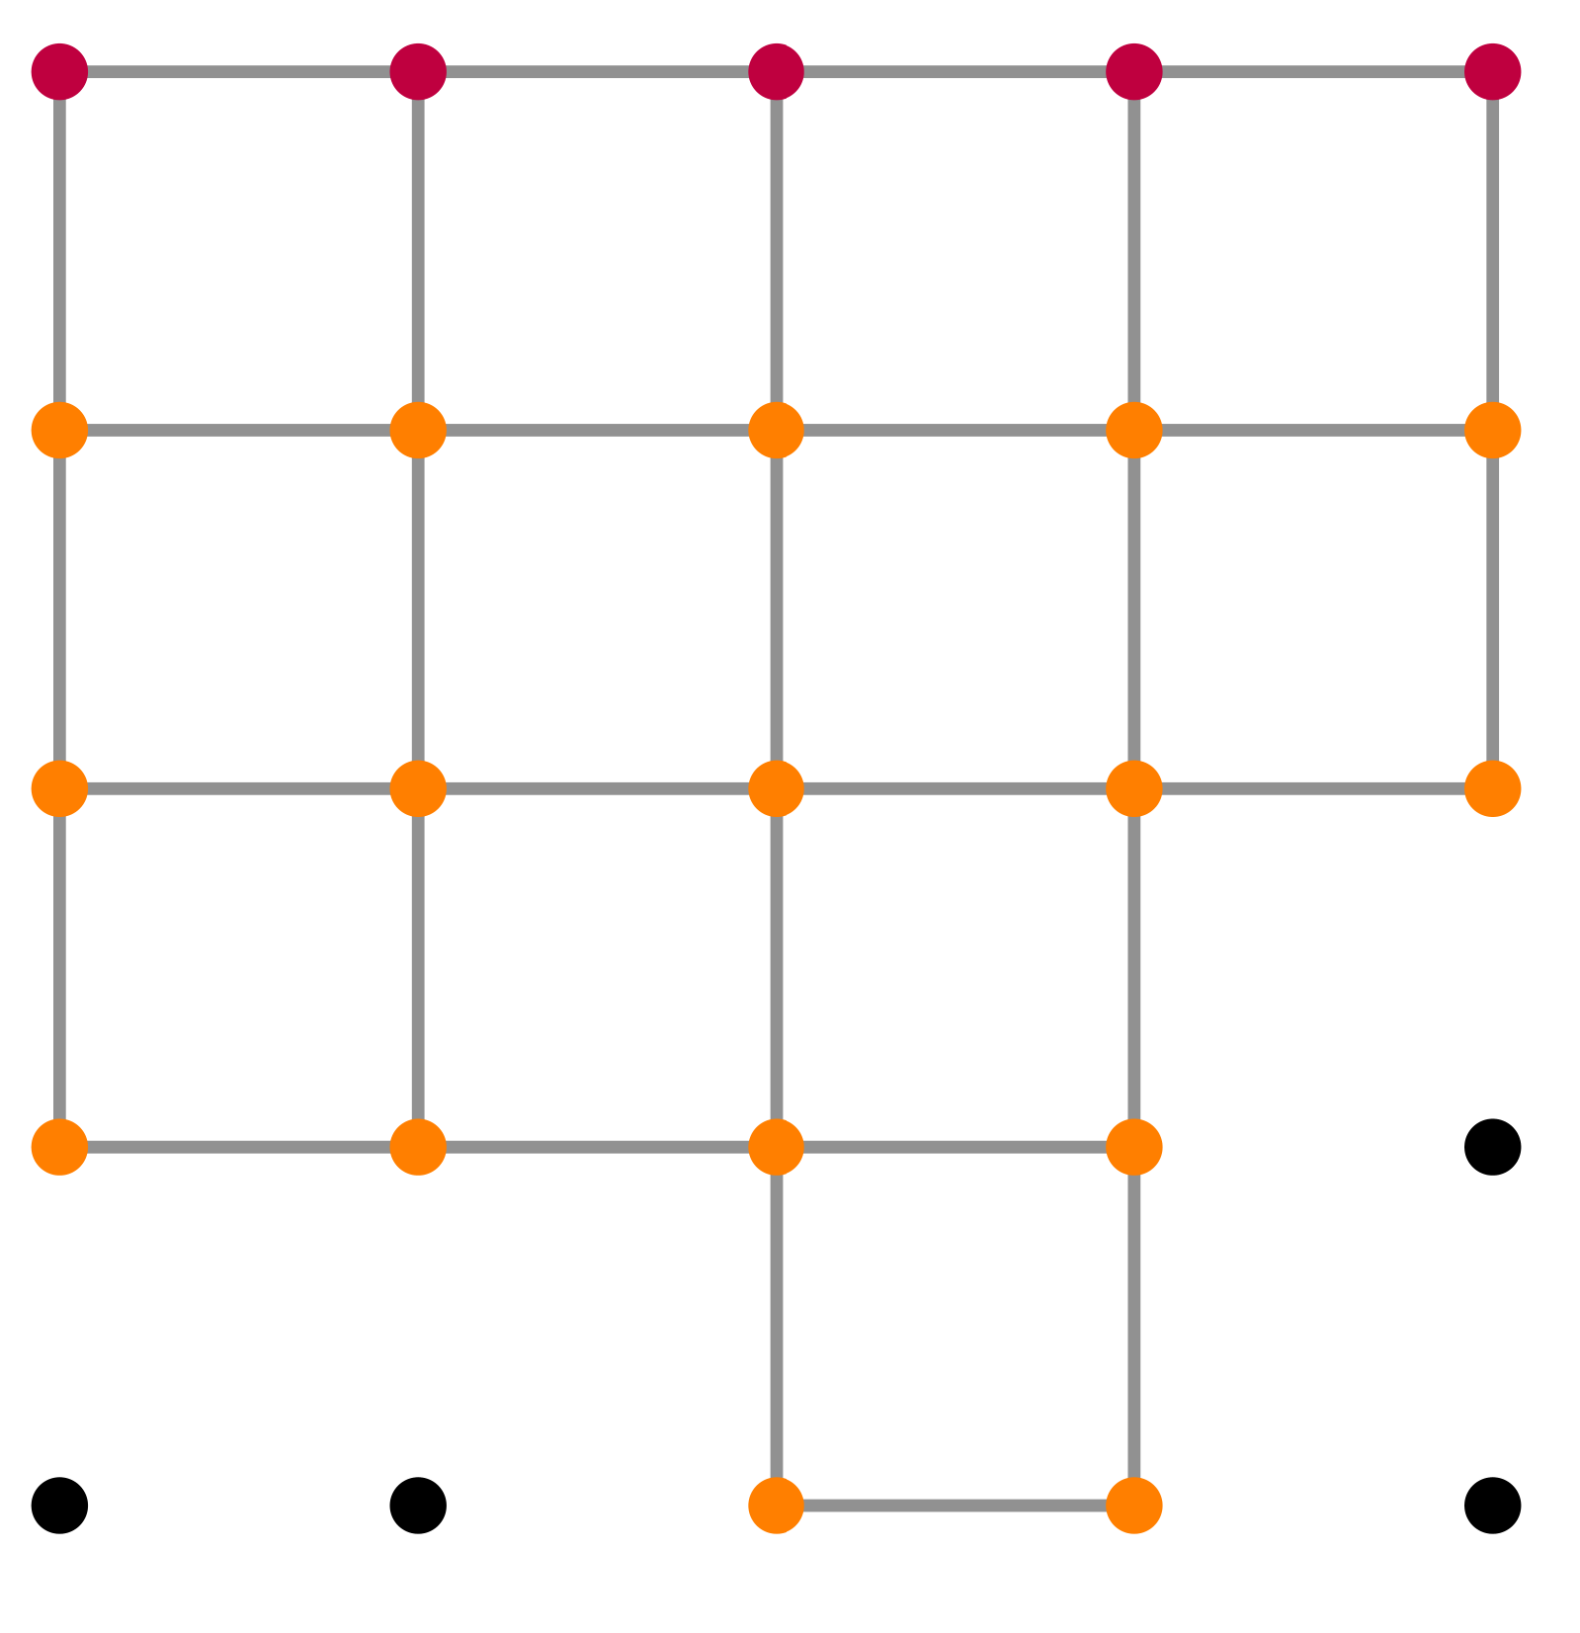


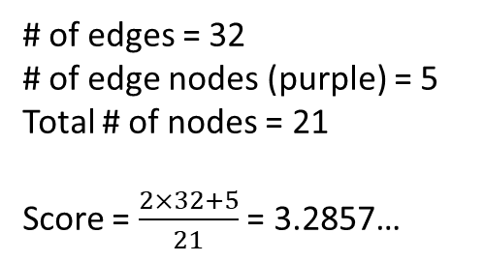
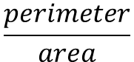
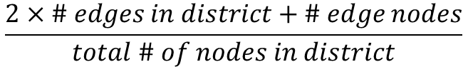
Compactness Score
My simulations used a minimum compactness score of 3.7.
Duchin formula:
$$\frac{perimeter}{area}$$
My score: 3.3
My formula:
$$\frac{2×\# edges in district+\# edge nodes}{total \# of nodes in district}$$
My score: 3.5
My score: 3.7
# of edges = 32
# of edge nodes (purple) = 5
Total # of nodes = 21
Score = $\frac{2×32+5}{21}$ = 3.2857…
My score: 3.9

Slide 11
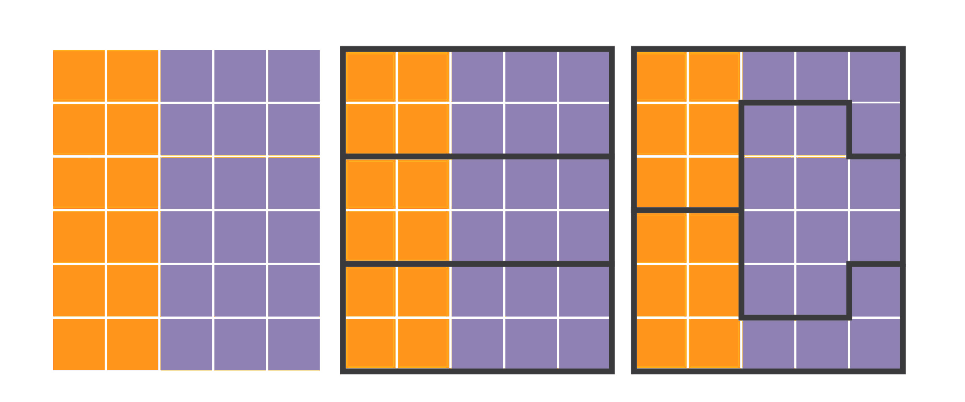
Strategies
Packing (Greedy): taking as many people as possible from one party and packing them into a singular or small number of districts.
Cracking (Barely-Winning): breaking up a group of people from a party throughout several districts so that they have majority in none.
Random: precincts chosen randomly, used as a baseline
Example state
Cracked districts
Packed districts

Slide 12
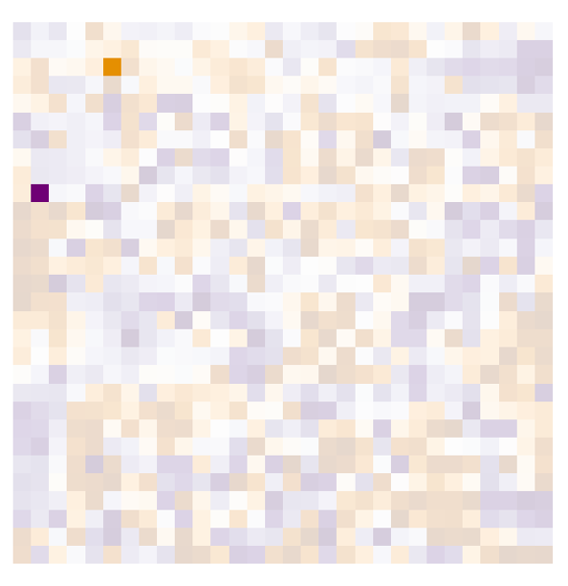
One Simulated Game
Implementation Details: I programmed this project in Python. The code used can be found at:
https://github.com/maia-pi
Graphs for the simulated states were made using the NextworkX package. This package also
was used to compute the connectivity of districts
and compactness-related statistics. Images were
created using the matplotlib Python Package.

Slide 13
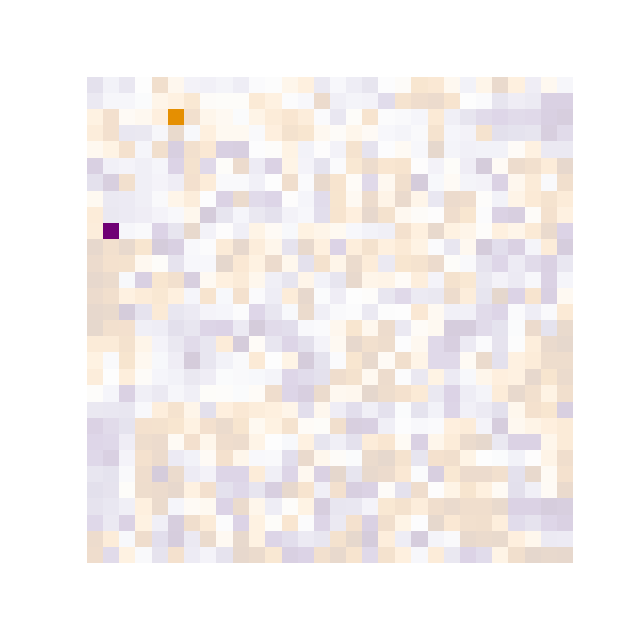
One Simulated Game
Implementation Details: I programmed this project in Python. The code used can be found at:
https://github.com/maia-pi
Graphs for the simulated states were made using the NextworkX package. This package also
was used to compute the connectivity of districts
and compactness-related statistics. Images were
created using the matplotlib Python Package.

Slide 14
Results: Samples from 990 Simulations

Slide 15
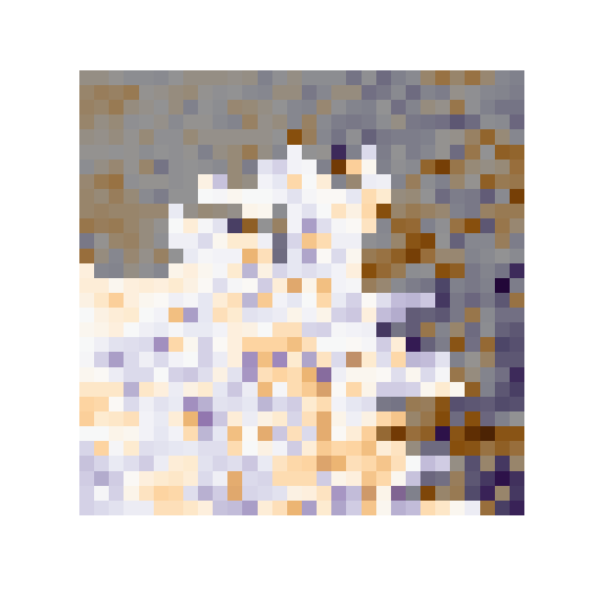
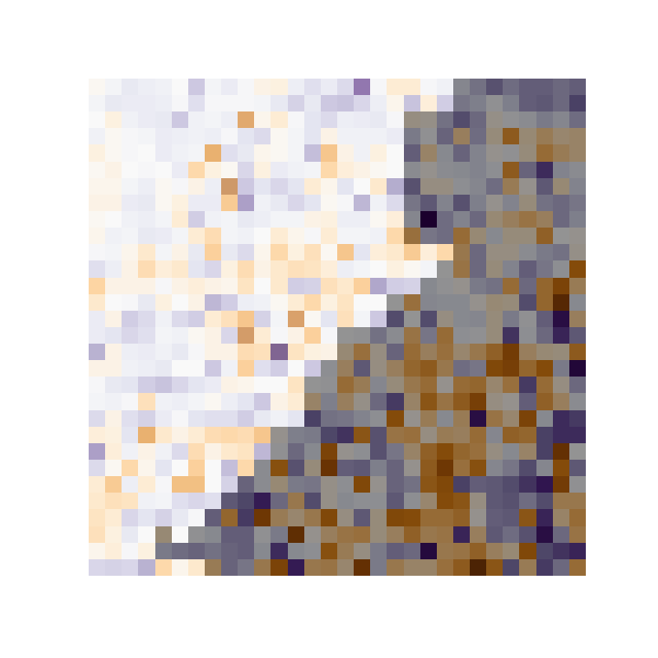
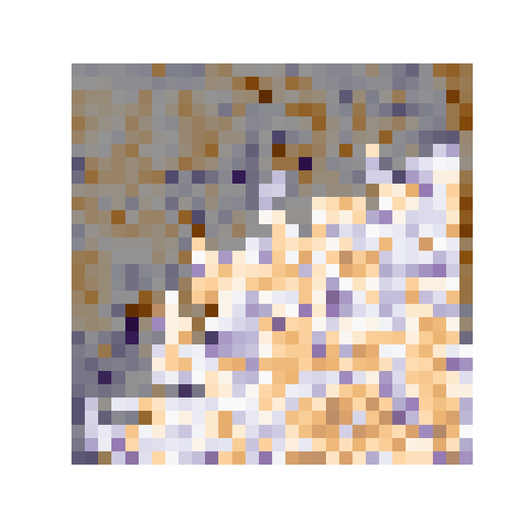
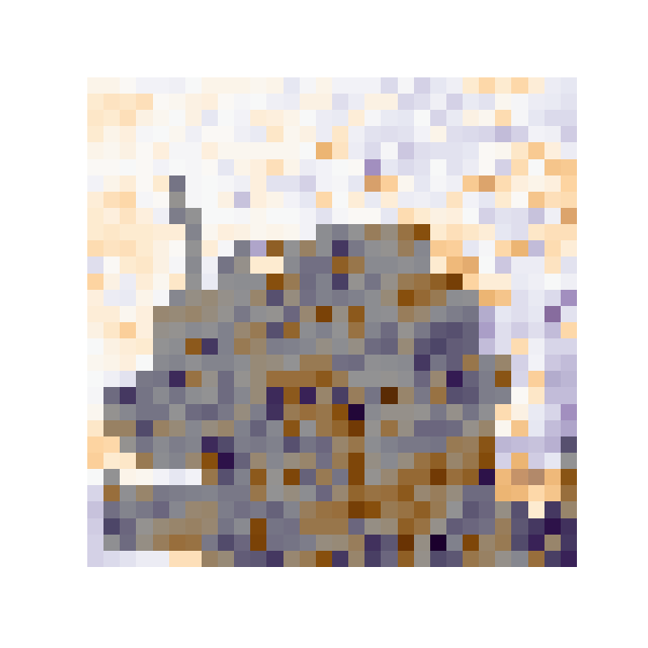
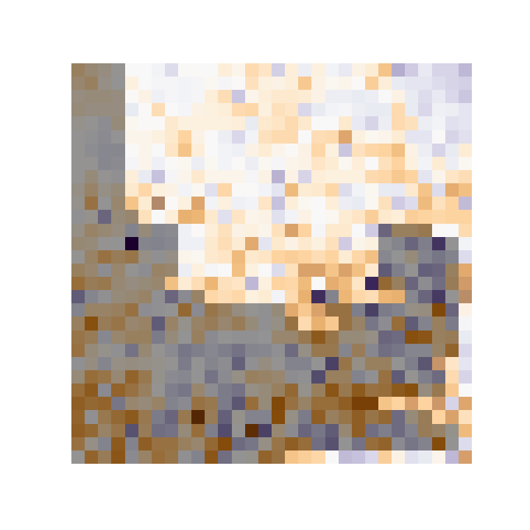
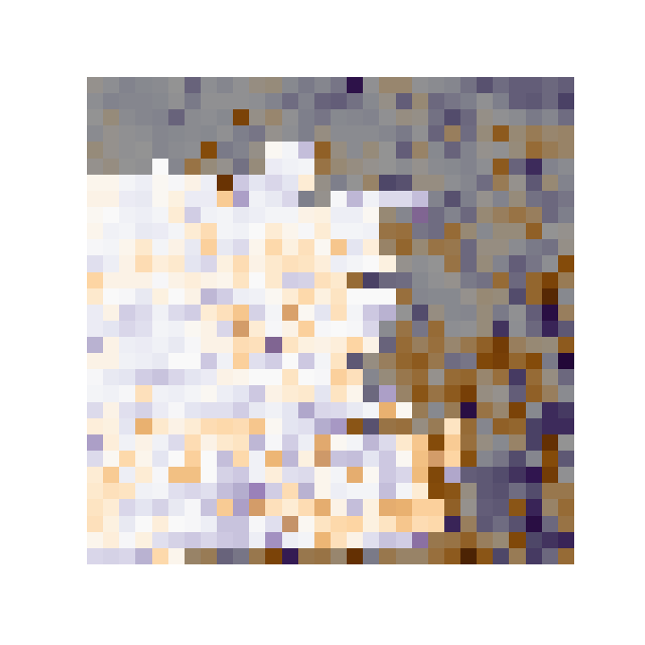
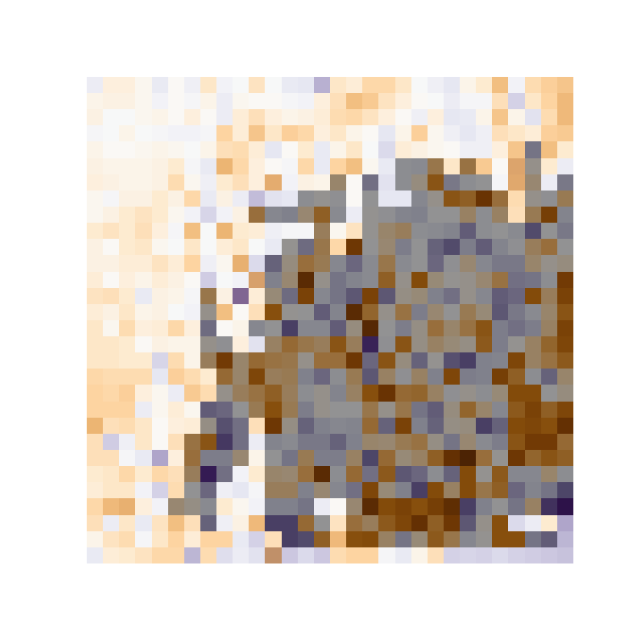
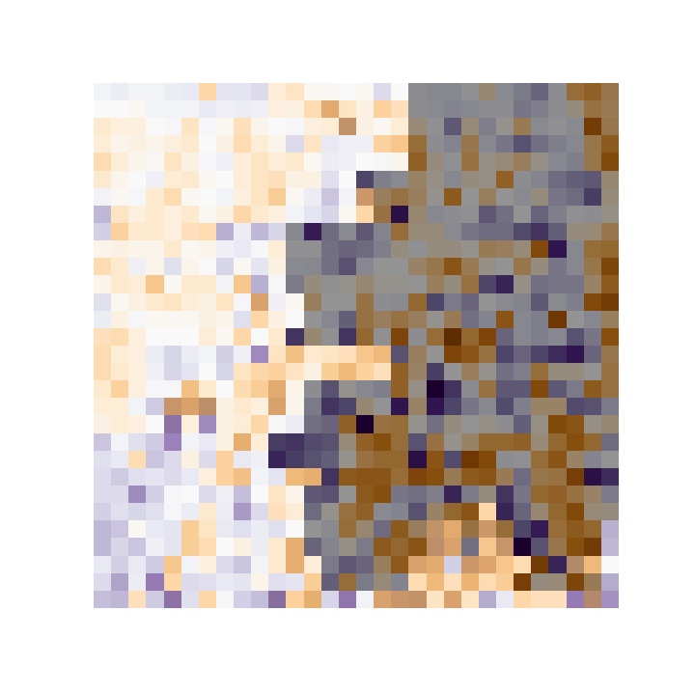
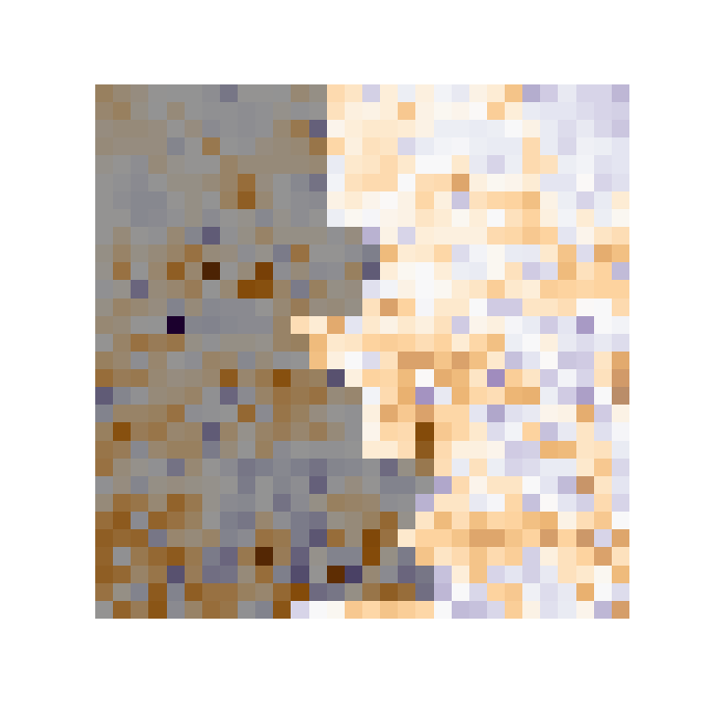
Random vs Random
Greedy vs Random
Barely
vs Random
Random vs Greedy
Greedy vs Greedy
Barely vs Greedy
Random vs Barely
Greedy vs Barely
Barely vs Barely

Slide 16
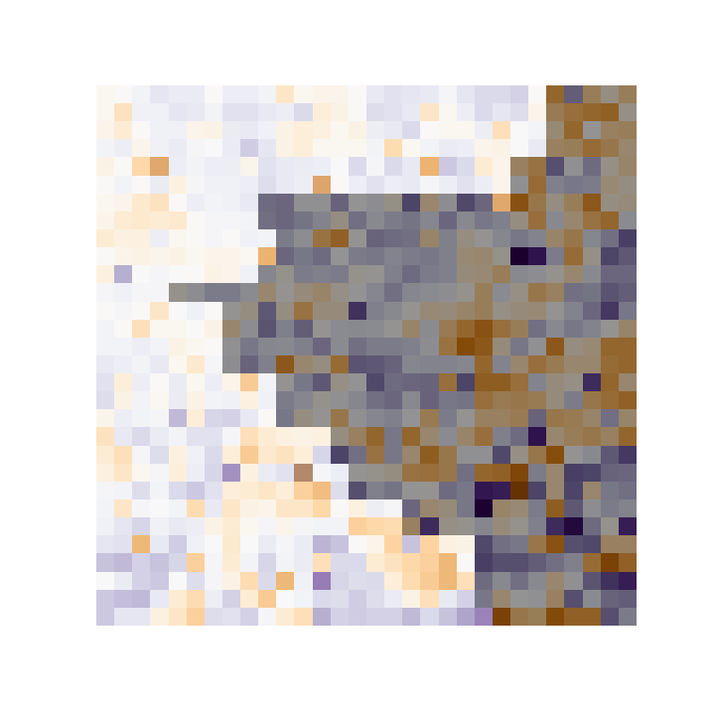
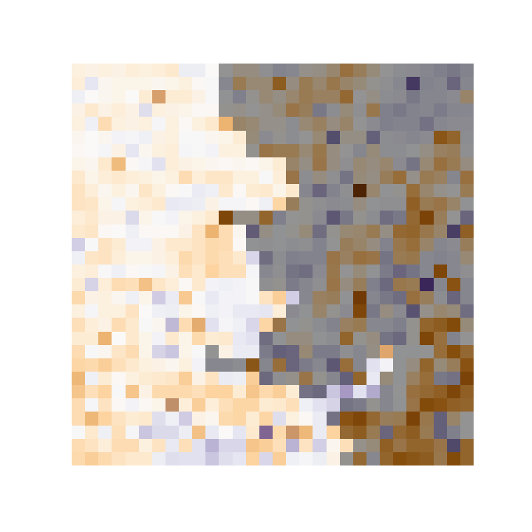
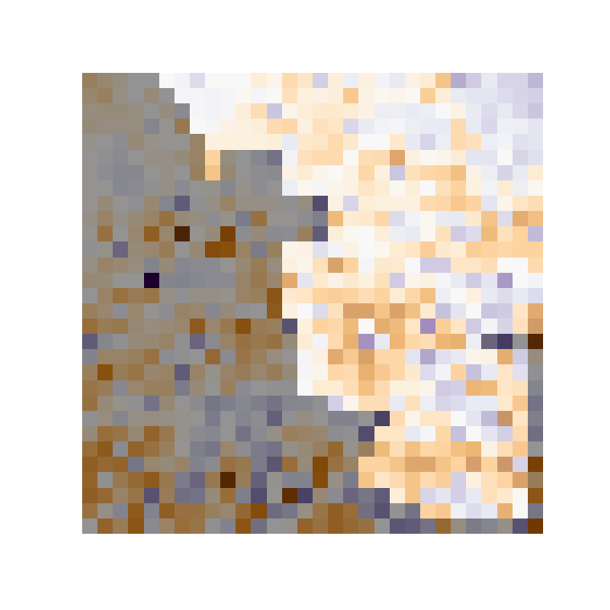
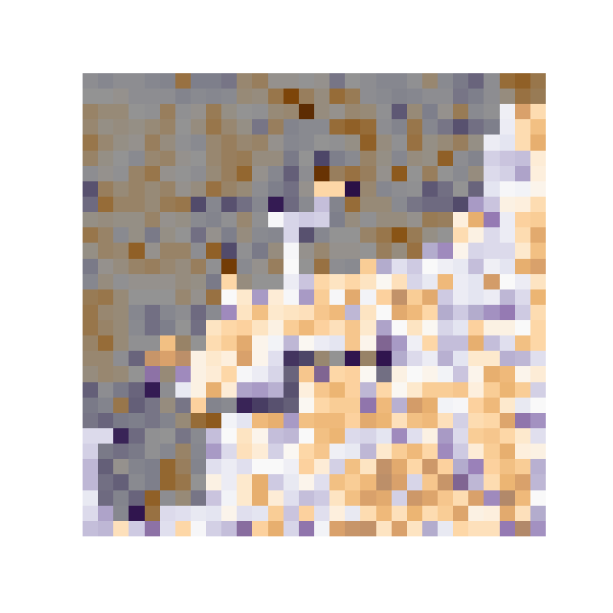
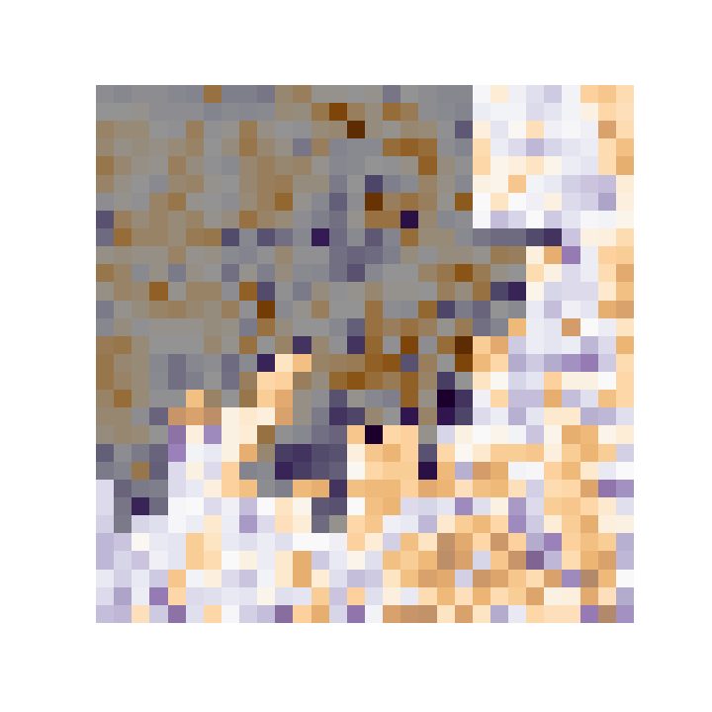
Barely vs Barely
Greedy vs Barely
Barely vs Greedy
Greedy vs Greedy
Greedy vs Barely

Slide 17
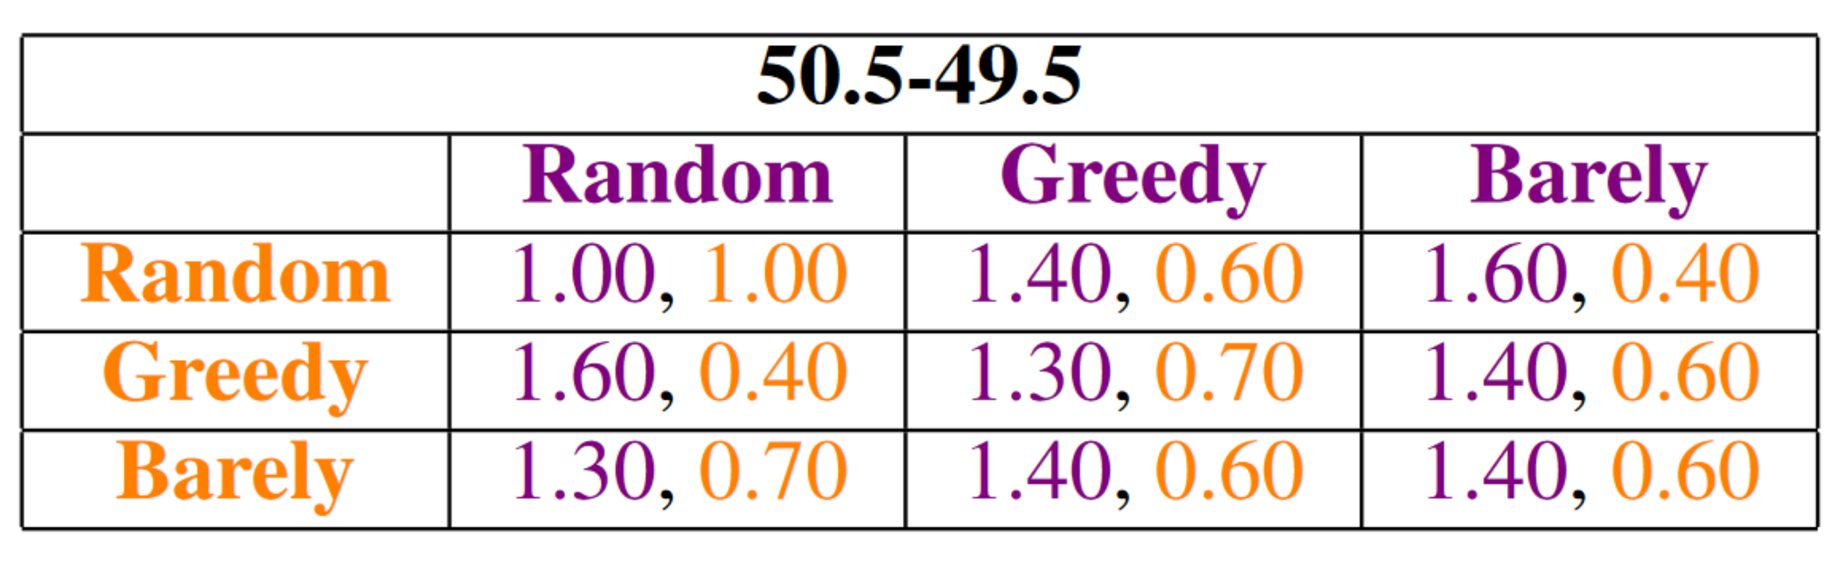
So Far…
The game completes every time
Districts created are continuous and compact
Question: What about simple dominant strategies?
Objectives: Purple wins both districts, Orange wins one district
Average Number of Districts Won by Strategy
Details:
Purple-Orange overall state voter split 50.5-49.5
Results based on 10 iterations per pair of strategies

Slide 18
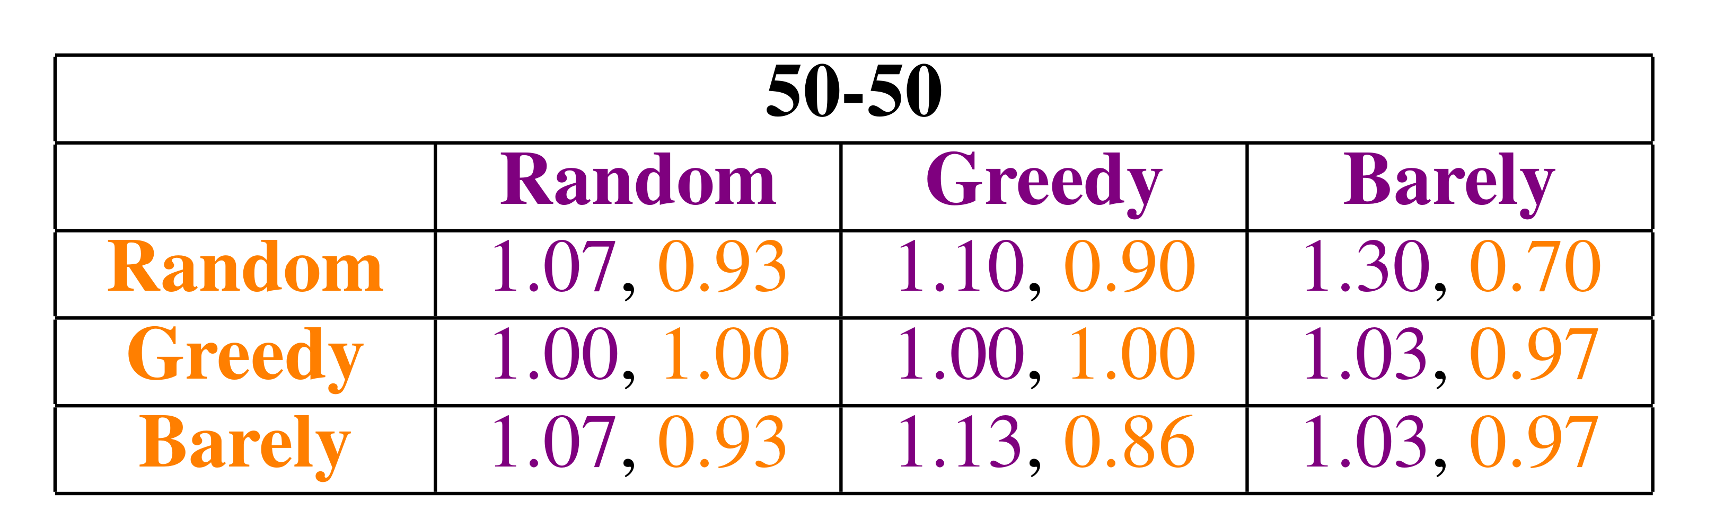
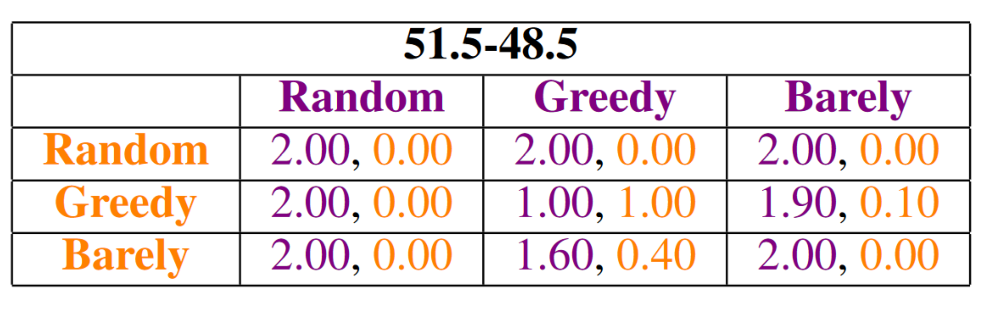
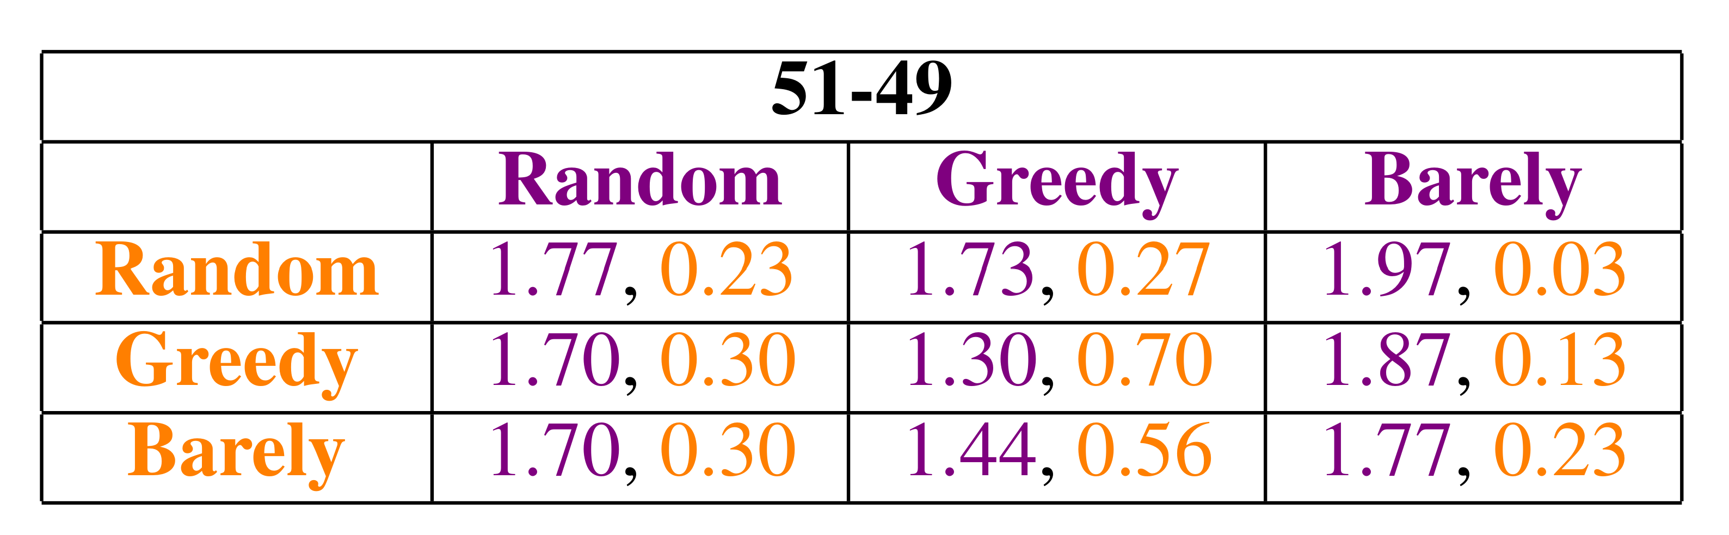
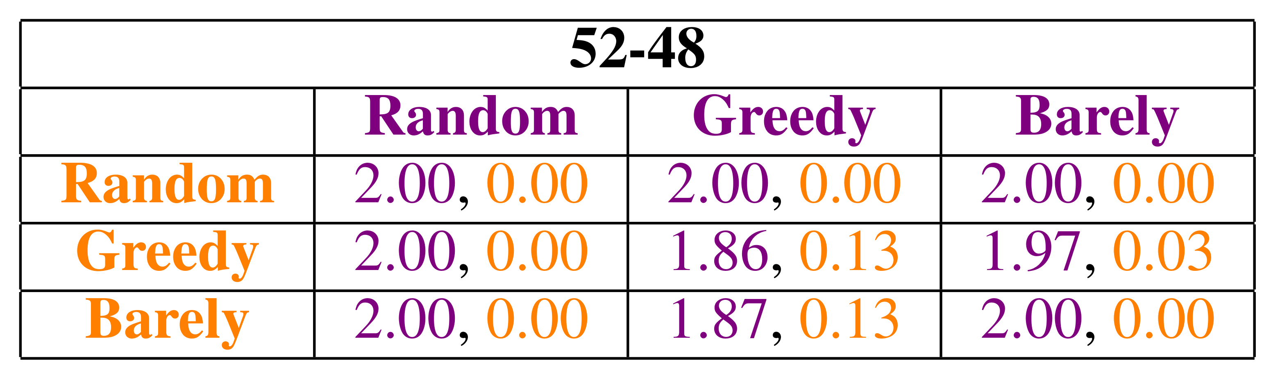
Average Number of Districts Won by Strategy
Details:
Purple-Orange overall state voter split
Results based on 30 iterations (10 for 51.5-48.5 and 50.5-49.5)
Compactness trade-off

Slide 19
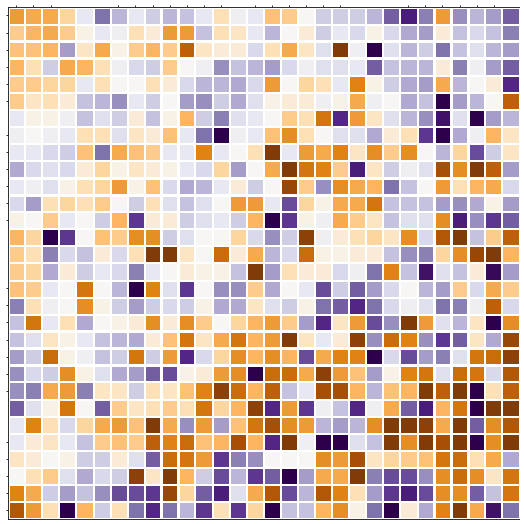
In Summary
The results are encouraging:
Game completes every time
Districts created are continuous and compact
No simple dominant strategy
Future Work
This provides evidence that game-based redistricting is viable. It would be valuable to repeat the project in more complex situations: non-rectangular states
Implement more voting parties and or allow for undecided/swing voters
Introduce more complex player strategies, such as extending strategies to look ahead to their next several moves while playing
Implement real-life data from states, including precinct layouts, voter distributions, etc.

Slide 20
References
[1] Jonathan C. Mattingly and Christy Vaughn. “Redistricting and the Will of the People”. The Mathematics ArXive arXiv:1410.8796 (2014). doi.org/10. 48550/arXiv.1410.8796.
[2] Moklos Bona. “Fundamental Algorithms”. In: World Scientific Publishing, 2017. Chap. 9.
[3] Wesley Pegden, Ariel D. Procaccia, and Dingli Yu. “A Partisan Districting Protocol with Provably Nonpartisan Outcomes”. The Mathematics ArXive arXiv:1710.08781 (2017). doi.org/10.48550/arXiv.1710.08781.
[4] Dustin G. Mixon and Soledad Villar. “Utility Ghost: Gamified redistricting with partisan symmetry”. The Mathematics ArXive arXiv:1812.07377 (2018). doi.org/10.48550/arXiv.1812.07377.
[5] Micah Altman and Michael McDonald. About the Data. publicmapping.org/resources/data.
[6] Moon Duchin. Explainer: Compactness, by the numbers. mggg.org/publications/political-geometry/01-Duchin.pdf.
[7] Ben Williams and Beth Hladick. Redistricting and the Supreme Court: The Most Significant Cases. ncsl.org/ redistricting-and-census/redistricting-and-the-supreme-court-the-most-significant-cases.

Slide 21
Thank You

Slide 22
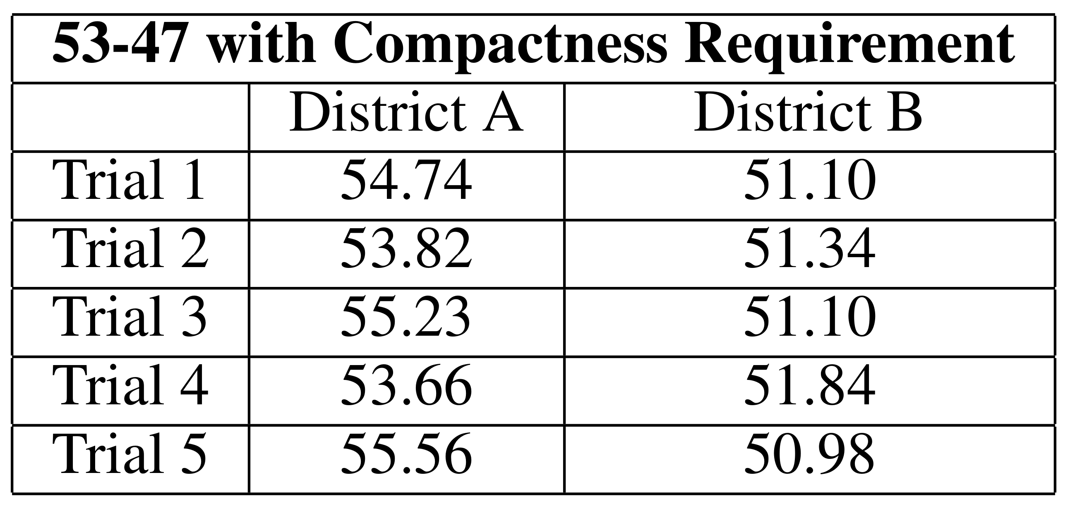
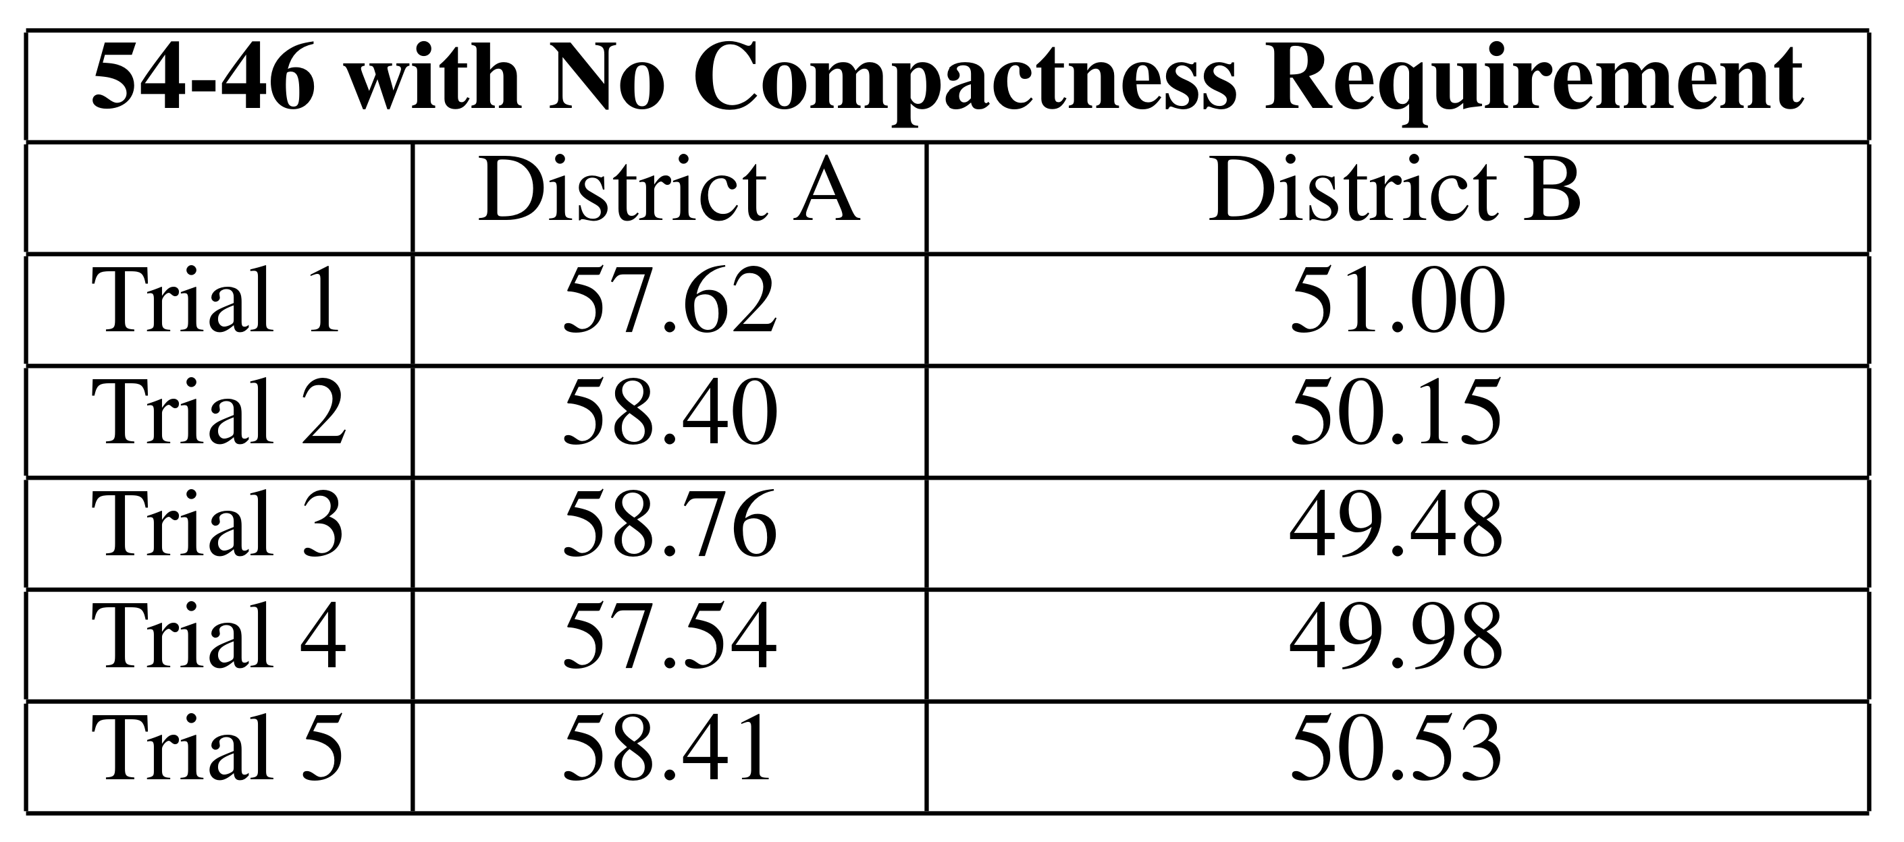
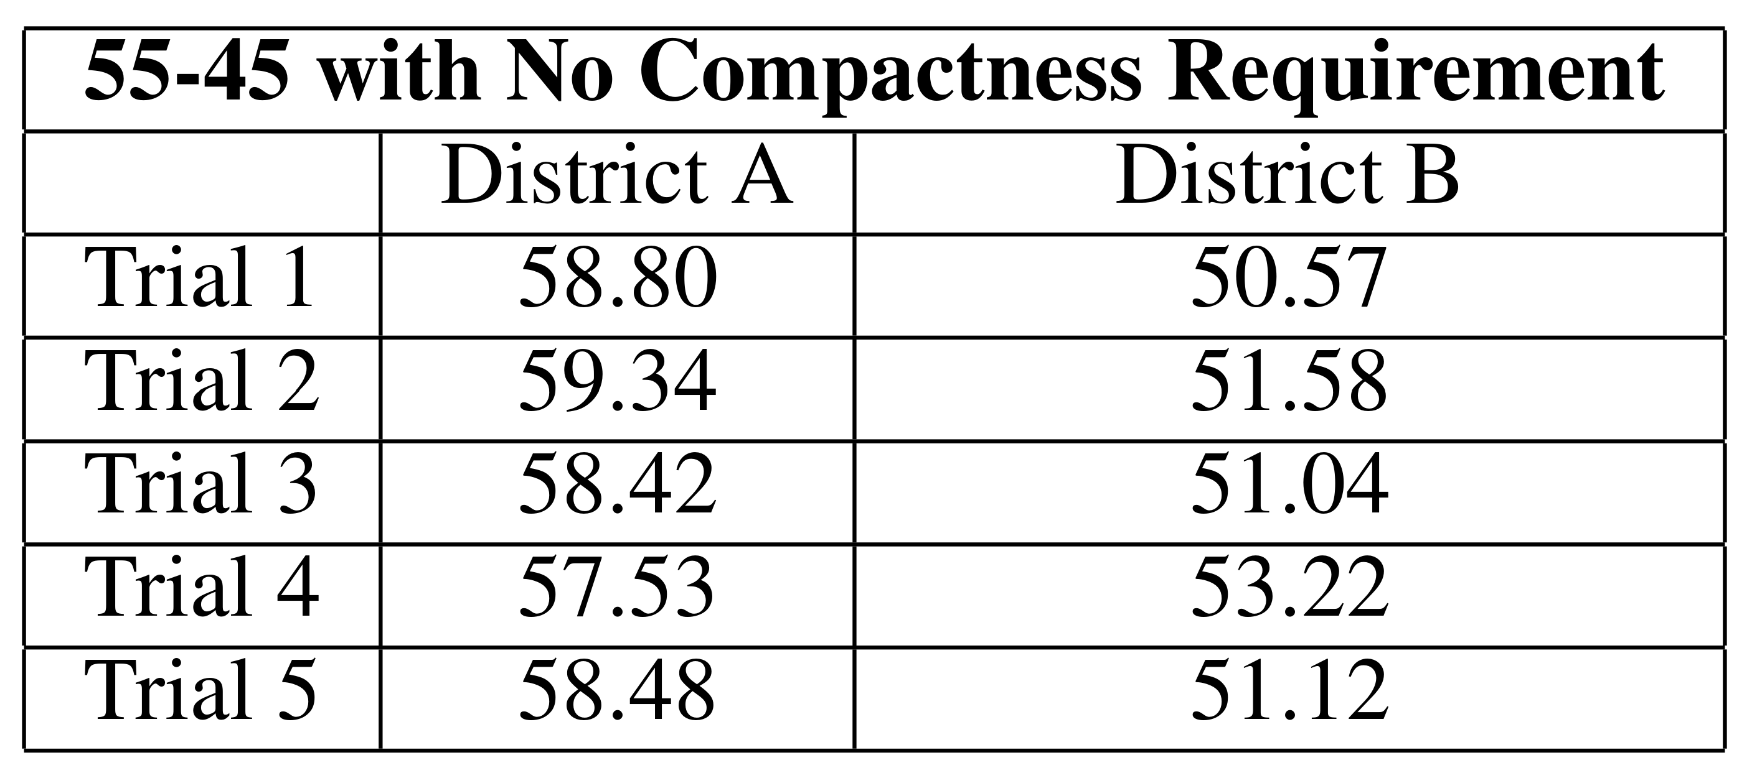
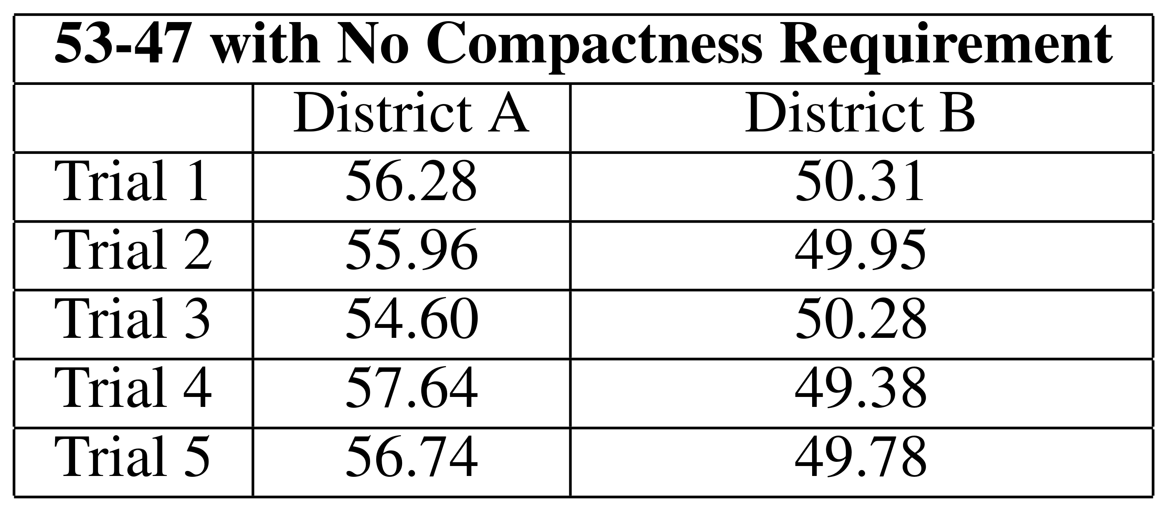
The Compactness Trade-Off
With lower compactness requirements, there is more leeway for the minority party to win.

